Slide 1
VIDAR: Visualization Interface for Data Analytics and Reduction
Oxford RSE Project
24 June 2024

Slide 2
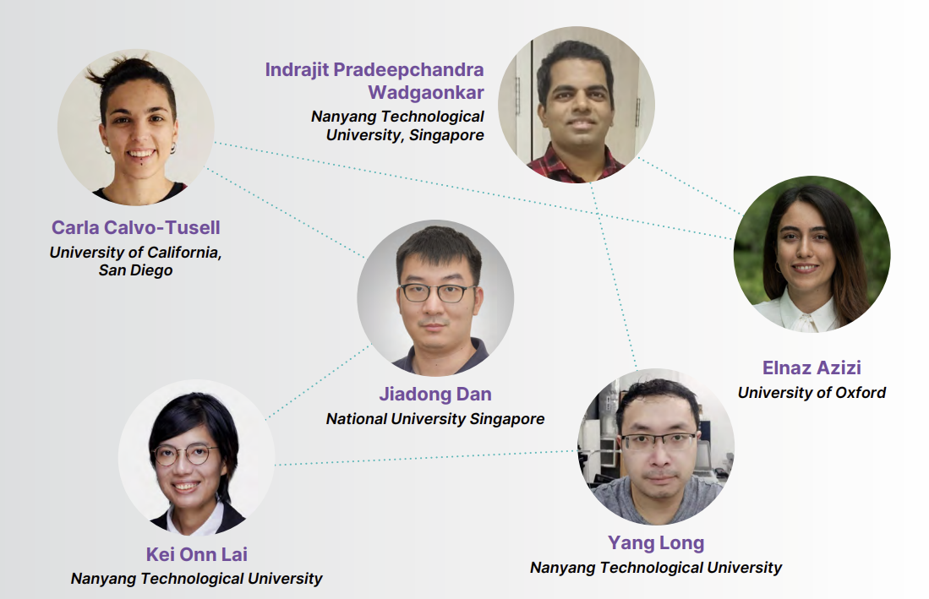
GitHub repo: VIDAR (pronounced as /ˈviː.dɑːr/)

Slide 3


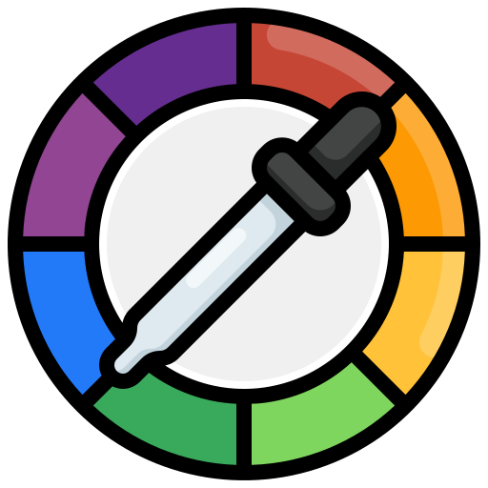

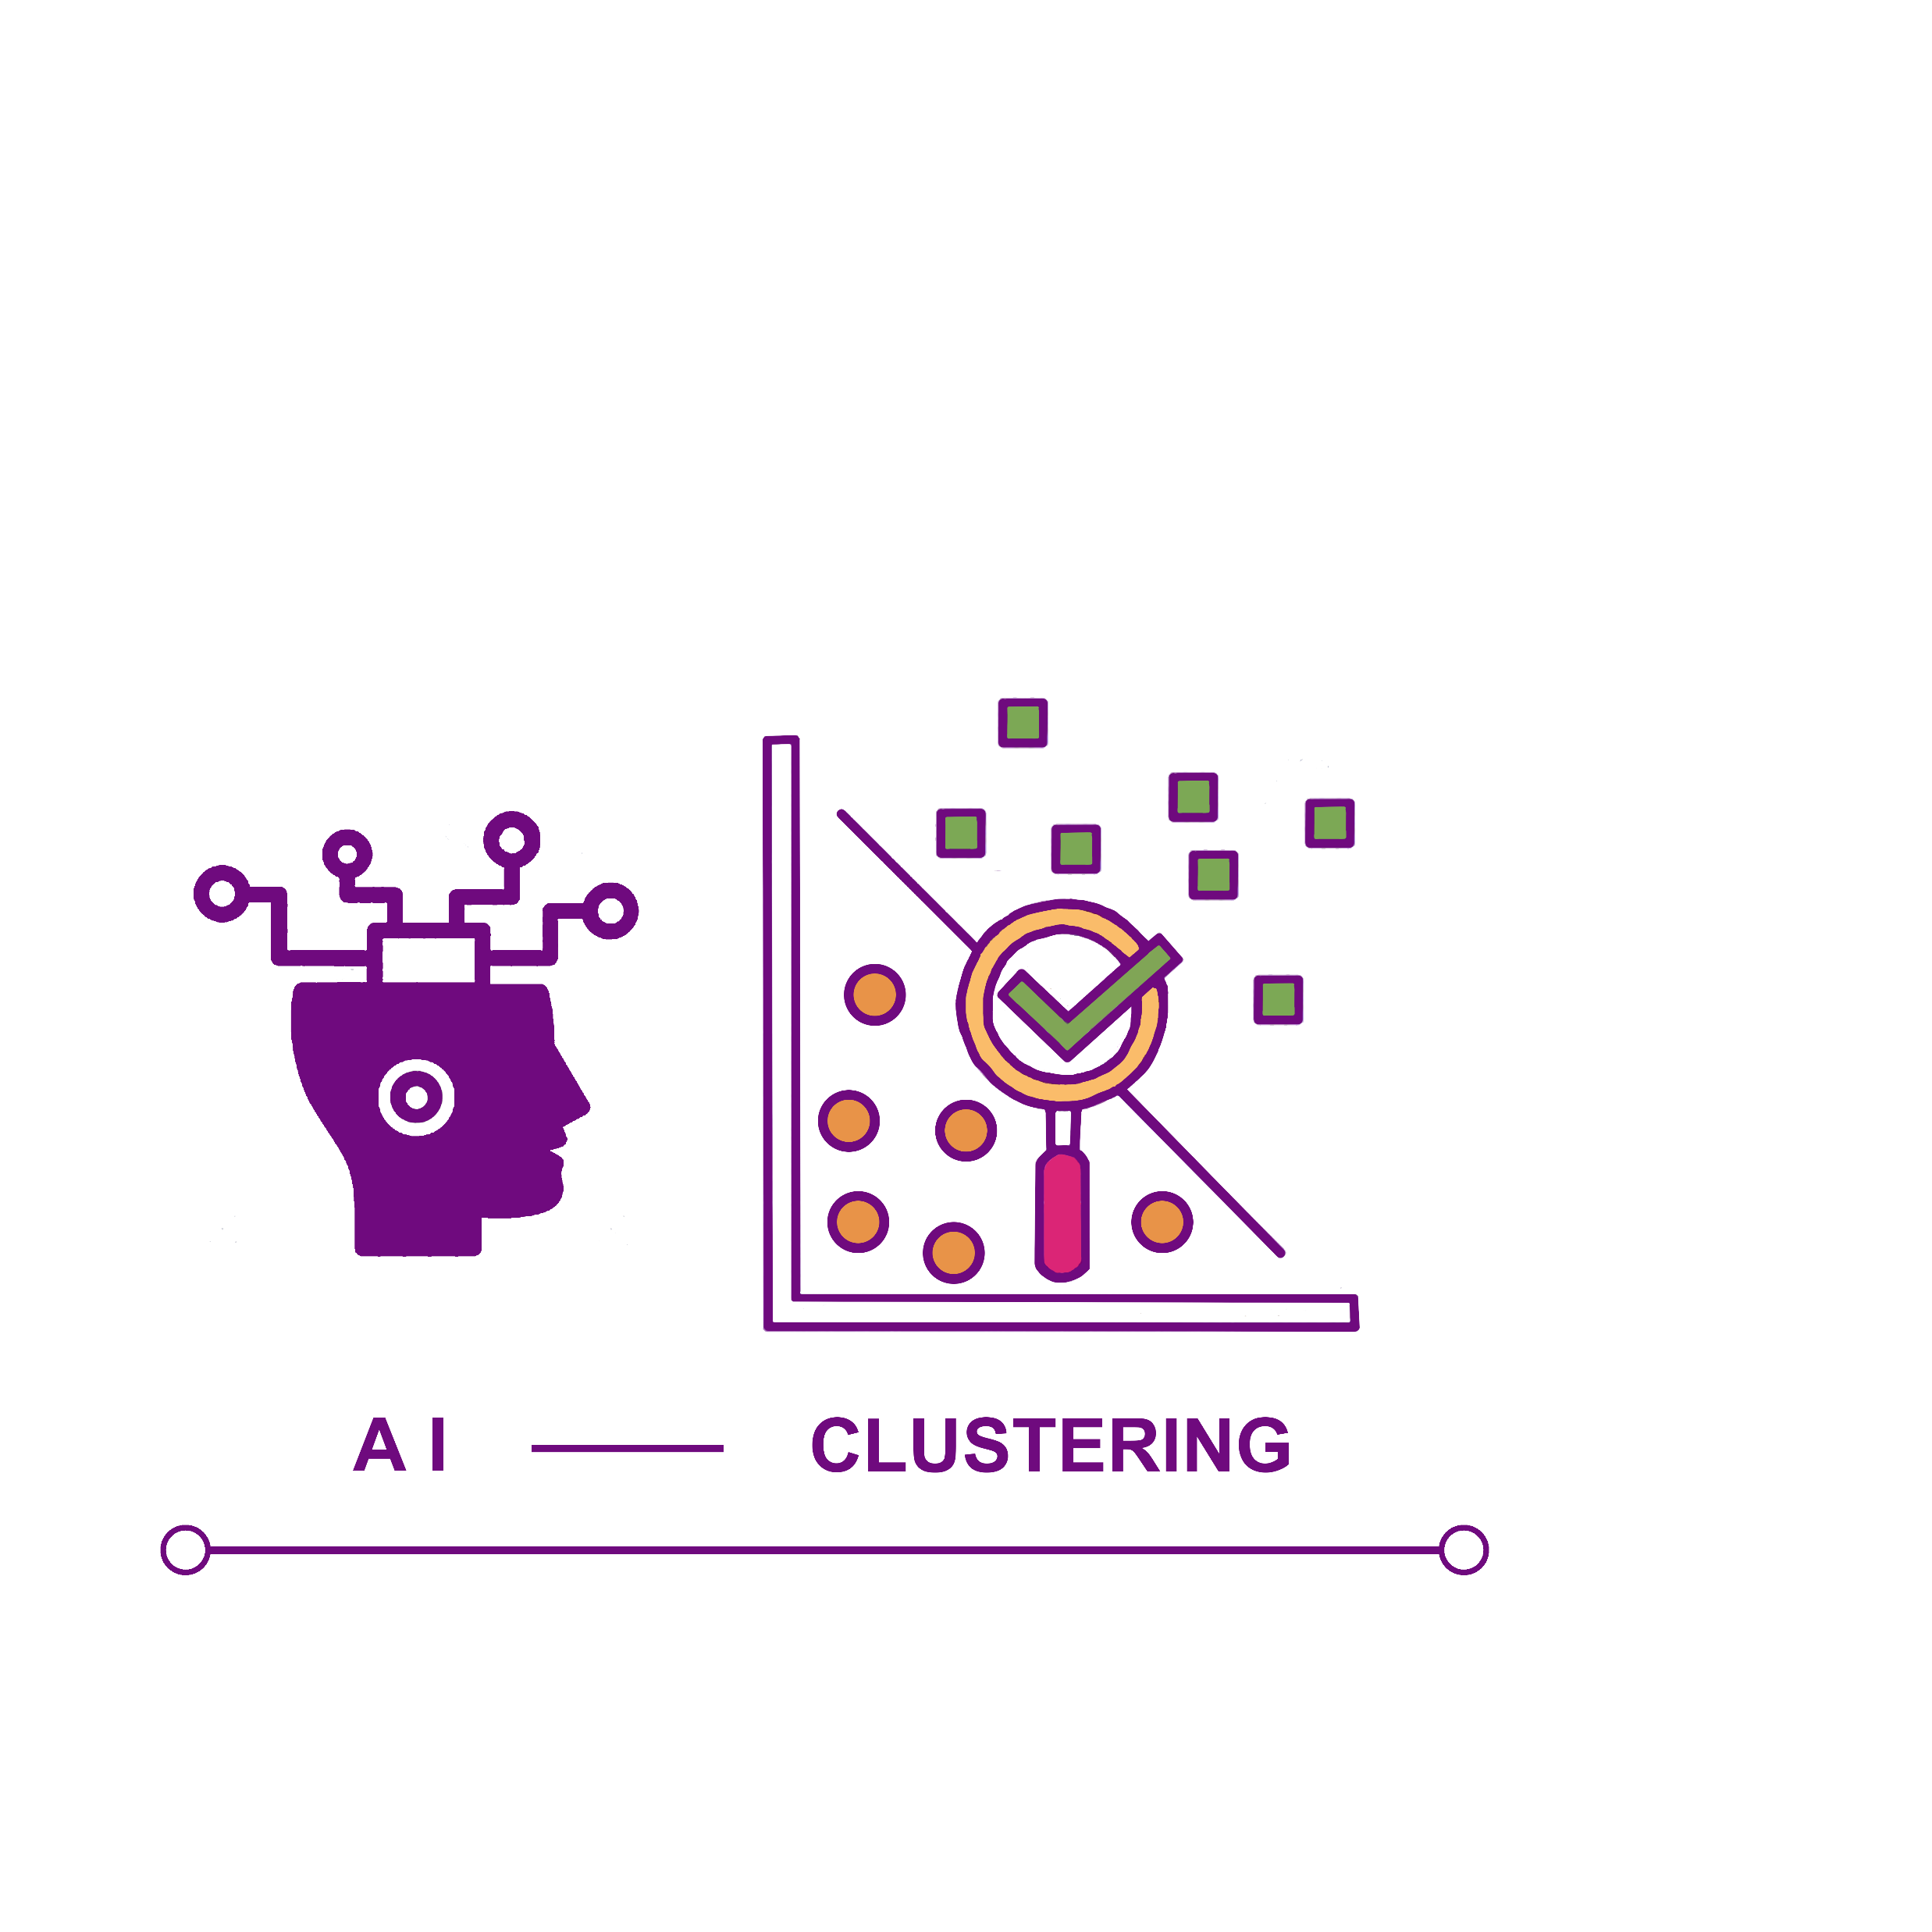
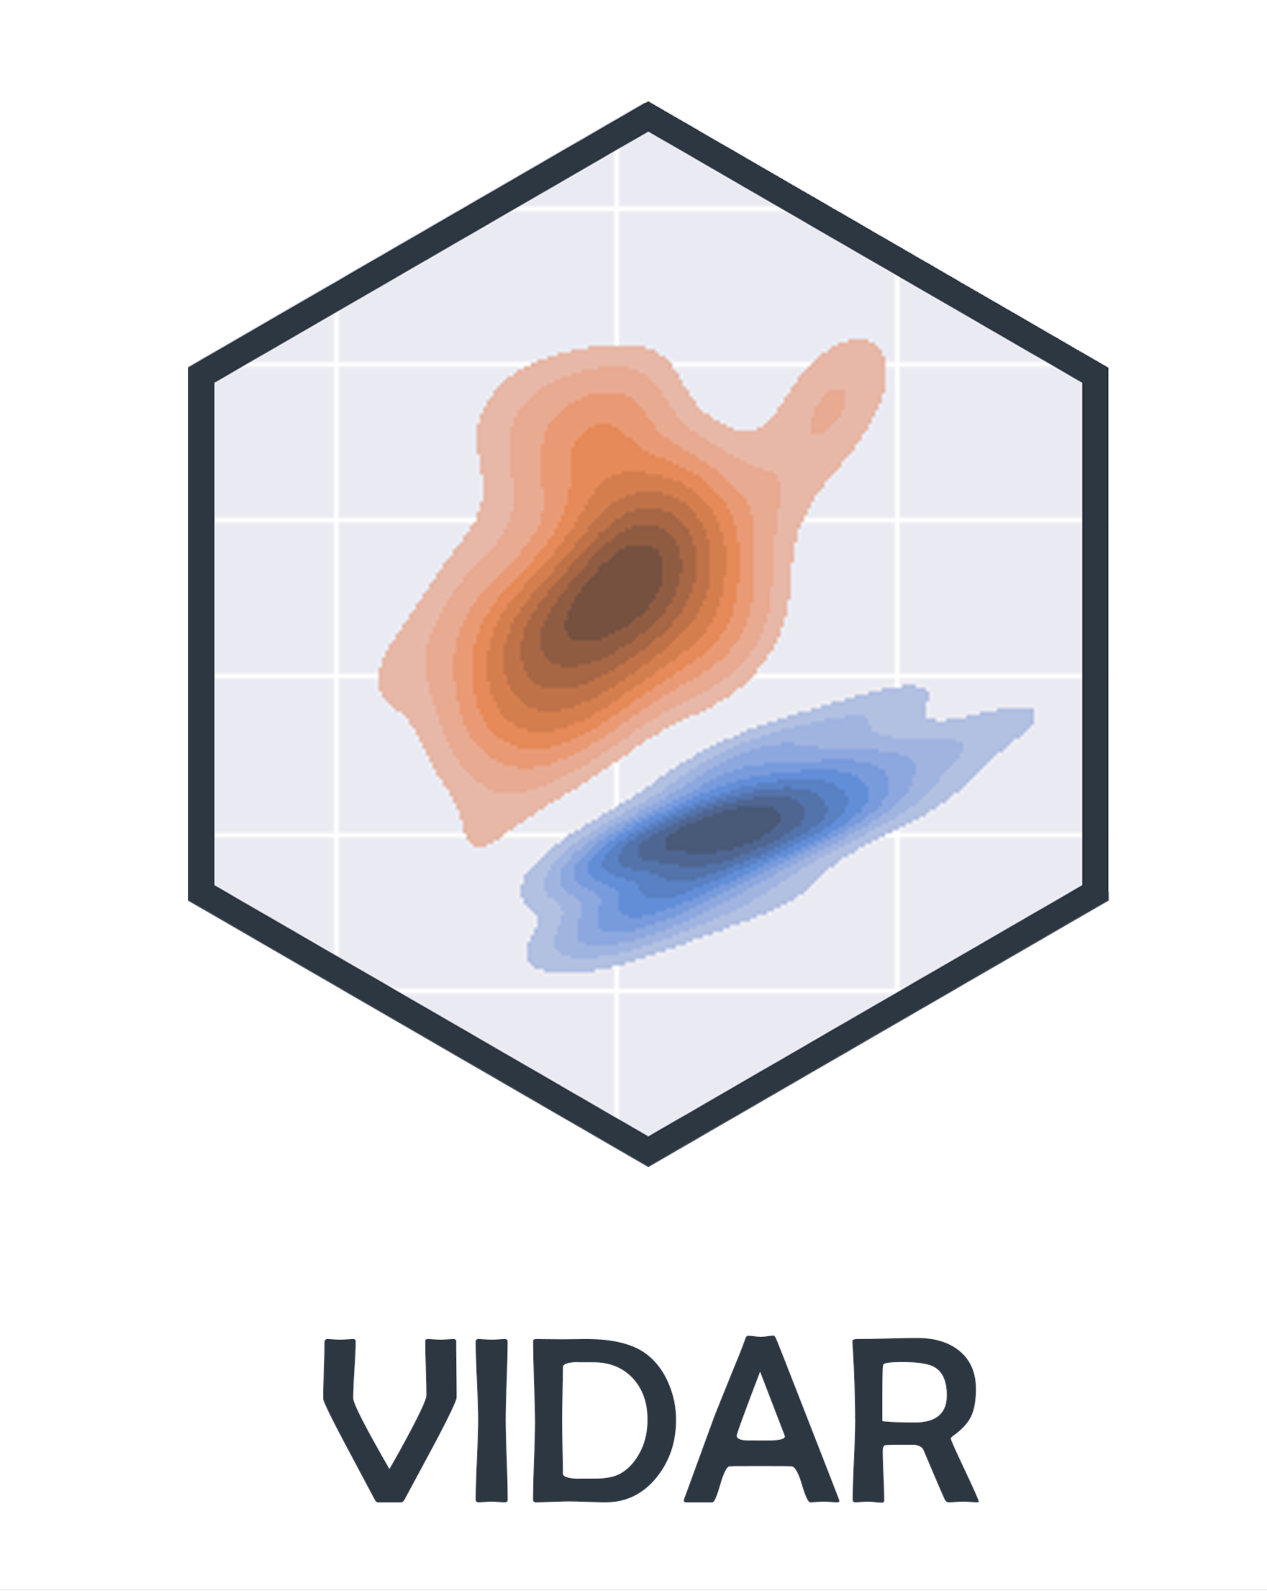

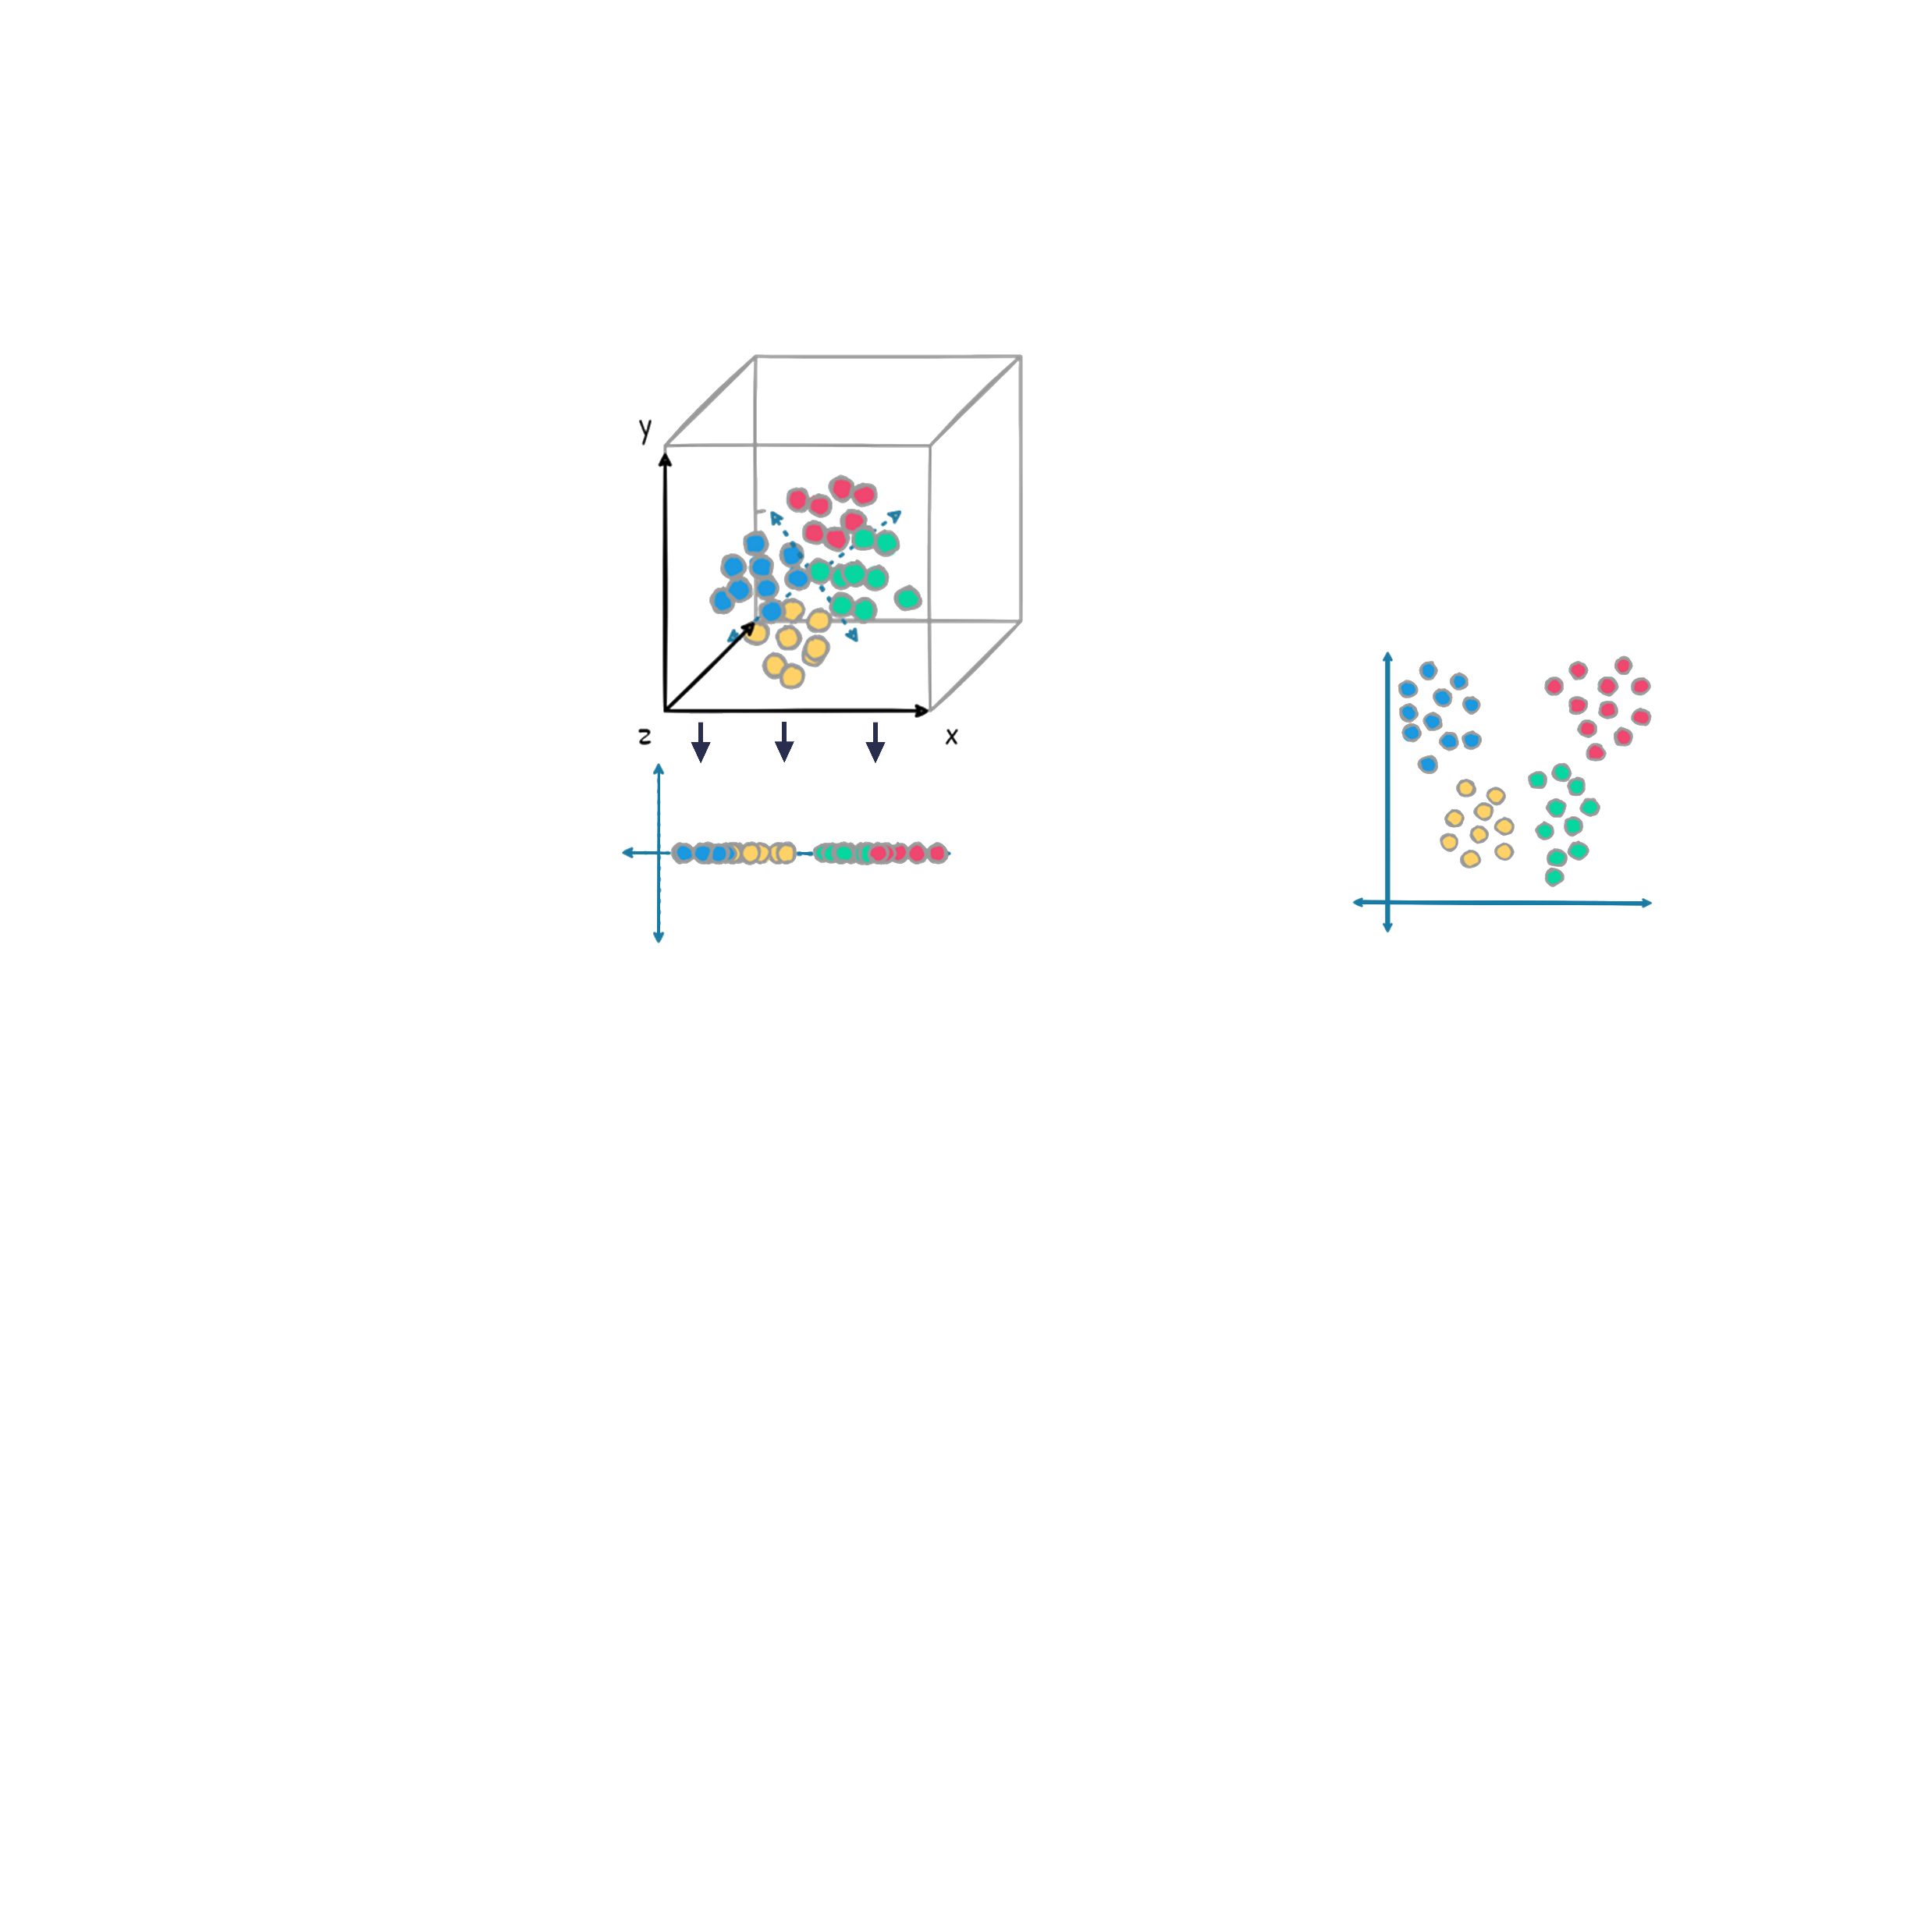

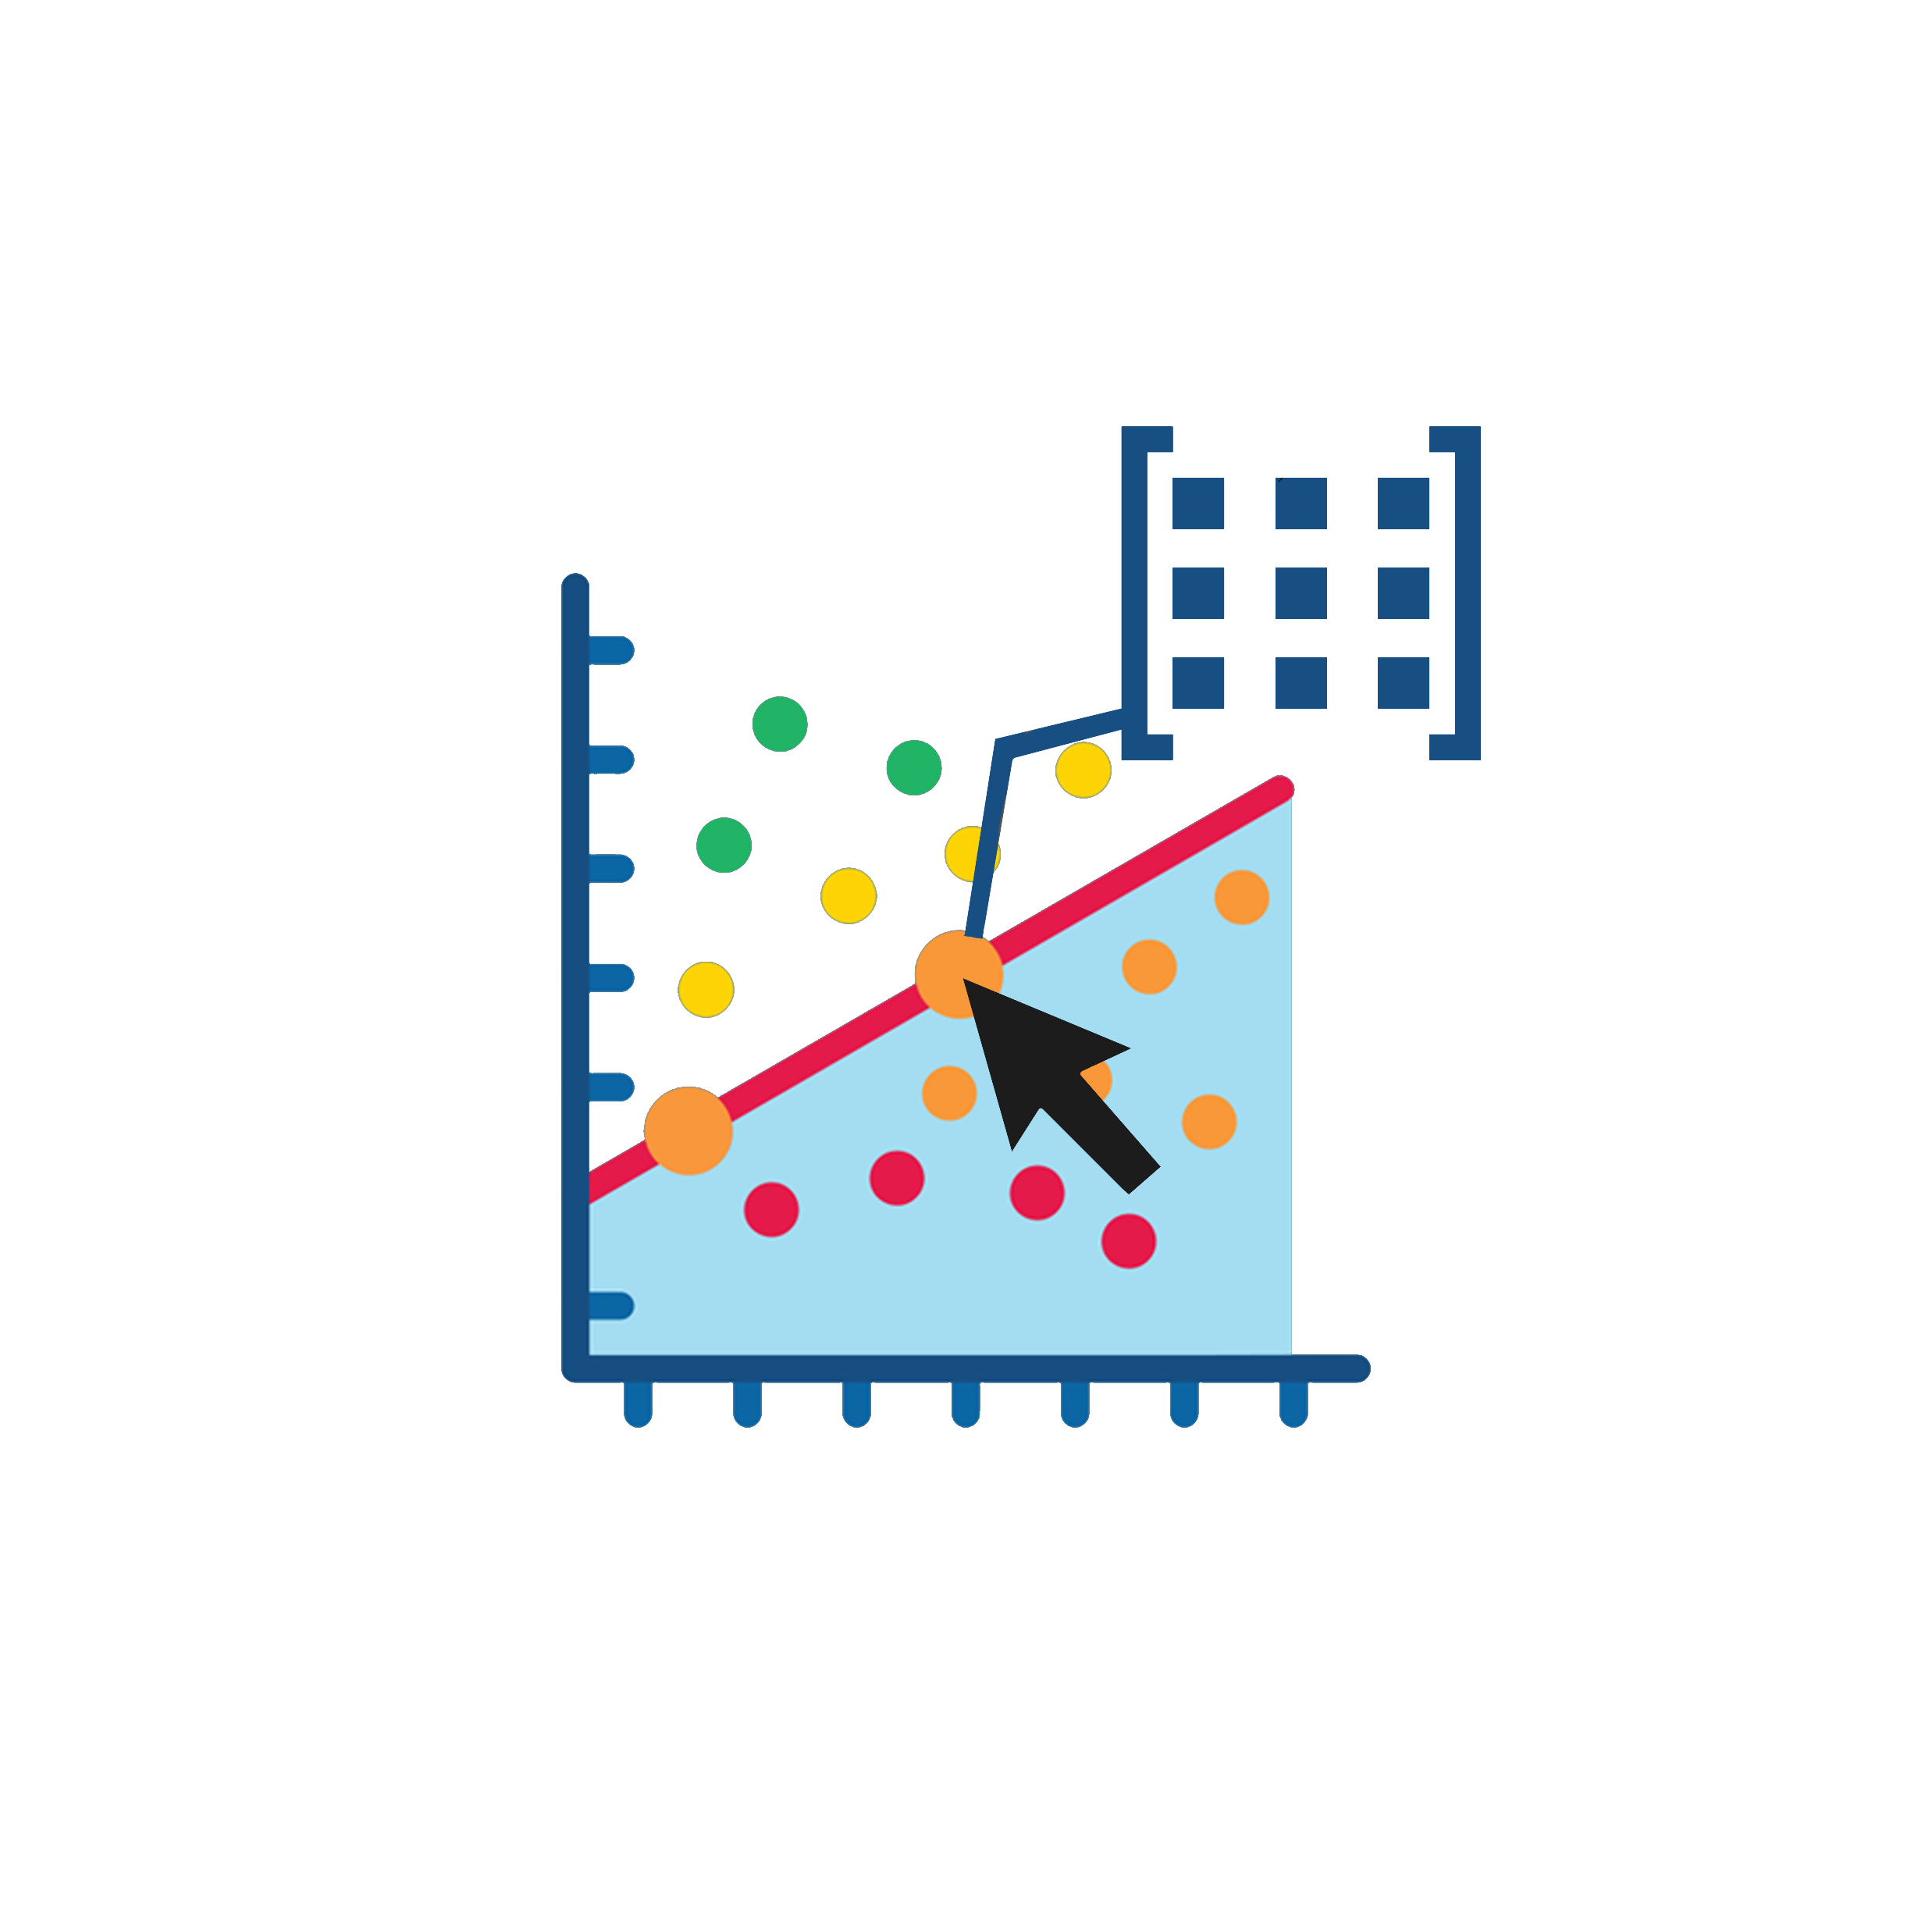

Deliverables
Interactive widgets which can be called from Jupyter notebook
Publish application or dashboard which is specifically designed for different fields (maybe build from Bokeh)
Tutorial resources on dimension reduction techniques (t-SNE, UMAP, FR)
Matplotlib
Colors
Bokeh
Clustering
scikit-learn
Dimension reduction*
NumPy
Interactive *
scikit-image

Slide 4
Demo

Slide 5
Demo

Slide 6
Demo

Slide 7

Project Plan: Remote working phase
Feature Development Month 1-2
Teams work on developing additional features and improving user interface. (Each fellow can develop a specific app that will work effectively in their fields.)
Emphasis on creating comprehensive documentation and tutorials.
Beta Testing & Feedback Month 3-4
Release a beta version to a small group of end-users.
Collect and incorporate user feedback for improvements.
Final Development Sprint Month 5
Address any remaining issues, finalize features, and polish the user interface.
Enhance documentation based on beta testing experience.
Release and Dissemination Month 6
Finalize the first stable release of the package.
Prepare a publication describing the software and its potential applications.
Plan and conduct a series of workshops/webinars for potential users. (optionally done by each fellow in their field involved in this project)

Slide 8
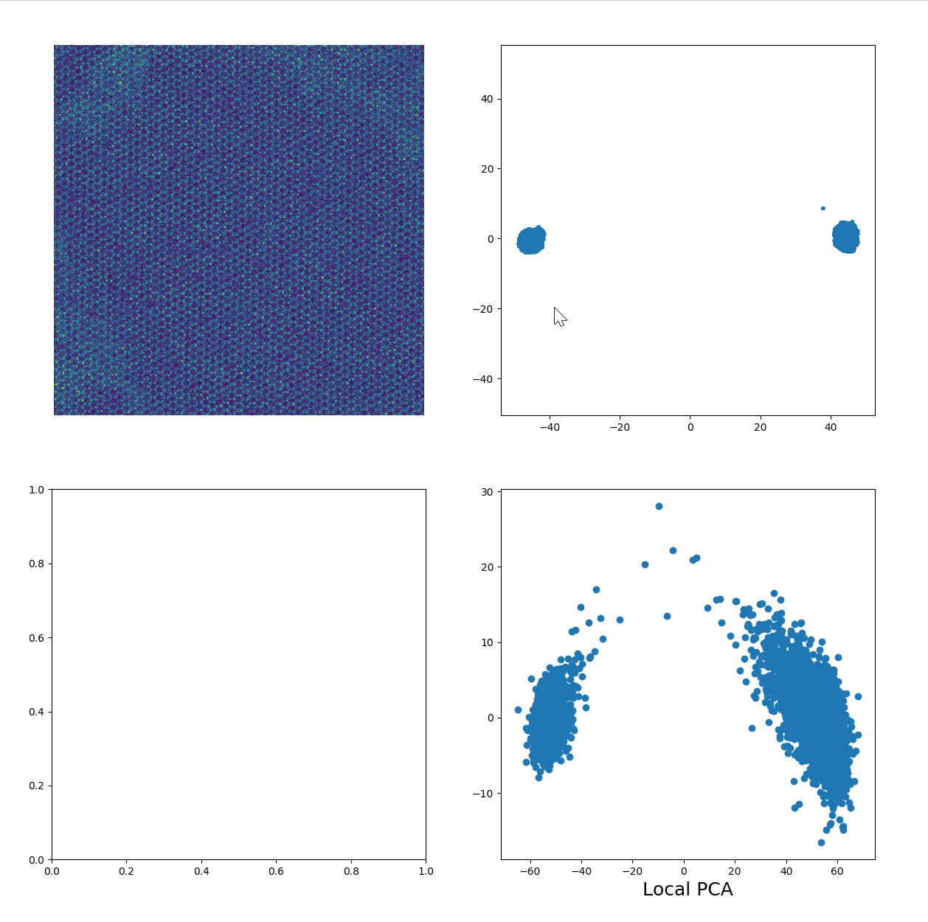
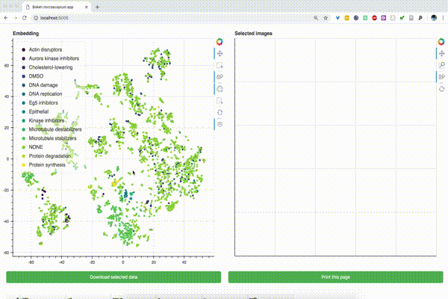
Simple demos

Slide 9

Goals for the team
We have the following goals:
🛠️ Determine Project Modules and Functionalities: Identify the modules and functionalities to be included in the project.
💻 Develop Core Functions and Classes: Complete writing the core functions and classes to ensure the project is at least usable by our team members.
🧪 Learn and Implement Pytest: Get familiar with pytest for testing our code.
📓 Create Tutorial Notebooks: Write clear and comprehensive tutorial notebooks for easy understanding and usage.
📚 [Optional] Write Documentation: Optionally, write detailed documentation for the project. (We also use LLM)

Slide 10
Thanks!

Slide 11
Project Plan: In-person Hackathon week
Introduction and Planning
Morning: Introduction session; overview of project goals and software requirements.
Afternoon: Split into teams based on skillsets and interests. Begin brainstorming and initial design.
Coding and Integration
Develop interactive components and integrate different programs from team members.
Start working on docstring and examples
Day 1
Day 3
Day 4
Day 5
Understanding Core Structure of Existing Code
Finding specific applications with different domains
Testing and Present Future Plans
Conduct internal testing and debugging.
Present the progress and future plans

